Slide 1
Excel Beginner for Library Class 1
iTeachXL
Frank Cerullo, CPM, MBA
fvcerullo@gmail.com
631-891-8037

Slide 2
Excel Beginner Agenda
Class 1 (Jan 20th)
Intro to Excel/What can it do for me?
Parts of the worksheet
Entering data
Formatting
Class 2 (Mar 24th)
Formulas and Functions
Class 3 (April 28th)
Sorting and Filtering data
Charts
Printing

Slide 3
Intro and what Excel can do for me

Slide 4
Introduction to Excel
Part of the MS Office suite
Common commands (I.E. ctrl-c = Copy)
Compatibility with other Office products: Word, PowerPoint, Access, Outlook
A spreadsheet: Accounting, ‘number crunching’, arithmetic and math, finance, statistics
Simple database; word processing; link to the web
Charts and Pivot Tables
Simple to learn, but as complex as you make it…
Multiple methods to accomplish the same thing
Keystrokes, Ribbon, Tabs, Mouse commands
Cannot cover everything – highlights only

Slide 5
What can Excel do for me?
If you organize data into ROWS and COLUMNS which allows you to ‘crunch numbers’, but also:
Use arithmetic Functions, statistical Functions, financial calculations, Logic and Look-ups functions
Create Lists, Calendars, Reports, PivotTables
Create professional looking Charts and Graphs
Print or share secure worksheets and workbooks
** Certain Advanced topics may be mentioned or referred to briefly, but require more in depth explanation for this course

Slide 6
Parts of the worksheet

Slide 7
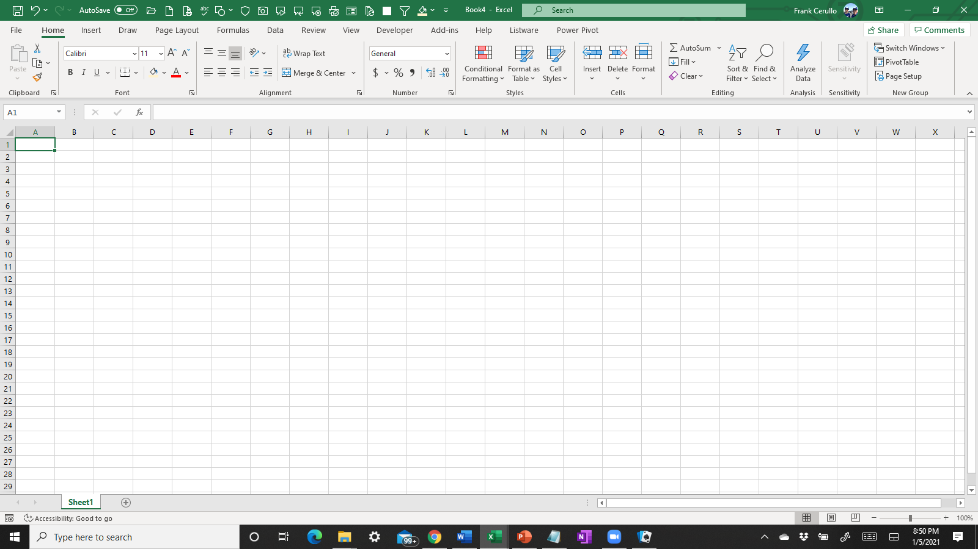
Key parts of the worksheet:
The Ribbon – (This changes depending on which TAB you are on)
Enter Functions, Formulas or Data in the “Formula Bar”
Tabs
Tabs Groups
Quick Access Tool Bar**
Dialog Box Launcher
The ‘Name box” shows where your cursor is currently located
Row headings: 1, 2, 3 etc...
Column headings: A, B, C etc...
Slide bars
ZOOM
(Adjust size)
Sheets (Sheet1, Sheet2 etc...)

Slide 8
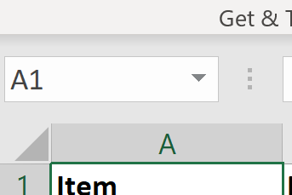
Navigating
End +
Over 16,000 Columns
End +
Use Name box to Go To cell A1
Over 1 Mill Rows
Each sheet has almost 17 Billion Cells

Slide 9
Ribbon
There are 7 Tabs:
Home, Insert, Page Layout, Formulas, Data, Review, View
Groups are the set of Commands for each Tab
example: Clipboard, Font, Alignment, etc.
Commands are the buttons or menus where we can ‘do’ something
Example: Wrap text, Format Cell

Slide 10
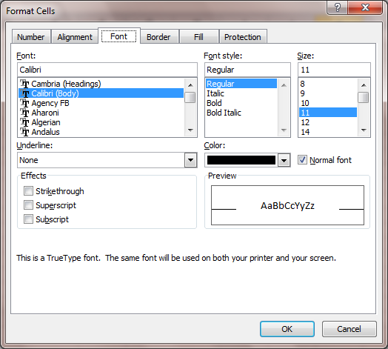
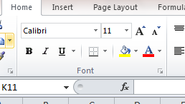
Dialog Box Launcher
Some Tab Groups have a Dialog Box Launcher, in the lower right corner
This means more options are available
Earlier version of Excel had a right facing arrow or showed 3 periods …

Slide 11
Home
This controls the “Look and feel” of your sheet
Font
Alignment
Number
Styles
Useful for some automatic formatting
Editing
Shortcut for simple functions, also Sorting and Filtering

Slide 12
Insert
Pivot Table and Charts
Sparklines are small graphs that fit in a single cell

Slide 13
Page Layout
Can do all the same actions:
Set Margins, page width/ height etc..
Can use pre-set ‘Themes’

Slide 14
Formulas
Simplifies the creation of formulas and using Functions
If you are using functions for the first time, this is a useful way to look at them, and to find others you may not be familiar with

Slide 15
Data
Sorting & filtering is here again, but they are also on Home tab
Text to Column and Remove Duplicates are useful
Get External Data was in Excel 2003, but tougher to find/use
Notice that PivotTable are NOT part of Data Tab, although they were part of the Data menu path in earlier versions of Excel

Slide 16
Review
Spell-Checker
Comment control
Protect Sheet
Note: Protection of cells is in Formatting, not here; this is protection of the entire sheet/book

Slide 17
View
Control how you see the current workbook
Zoom and Freeze Pains are very useful
Switch Window used to flip between workbooks you have open, but not between sheets in one book

Slide 18
Entering data

Slide 19
Entering data into ‘Cells’
By organizing your data in a grid, with no empty columns or rows, Excel will automatically consider it a ‘range’ or dB, making sorting, filtering and Pivot Tables easier
Think of it as a list in a notebook binder
Enter by any of these methods:
Import from other sources (Access dB; Web; .txt; .csv; etc. files)
Link to other sources (other Excel worksheets, or workbooks)
Type directly into the cell
AutoFill – based on standard or Custom Lists
Cut-and-Paste from other sources

Slide 20
Entering data into ‘Cells’
In Row 1 we’ll use ‘titles’ to describe kind of information
In each column, we’ll enter the ‘data’ that we want to analyze

Slide 21
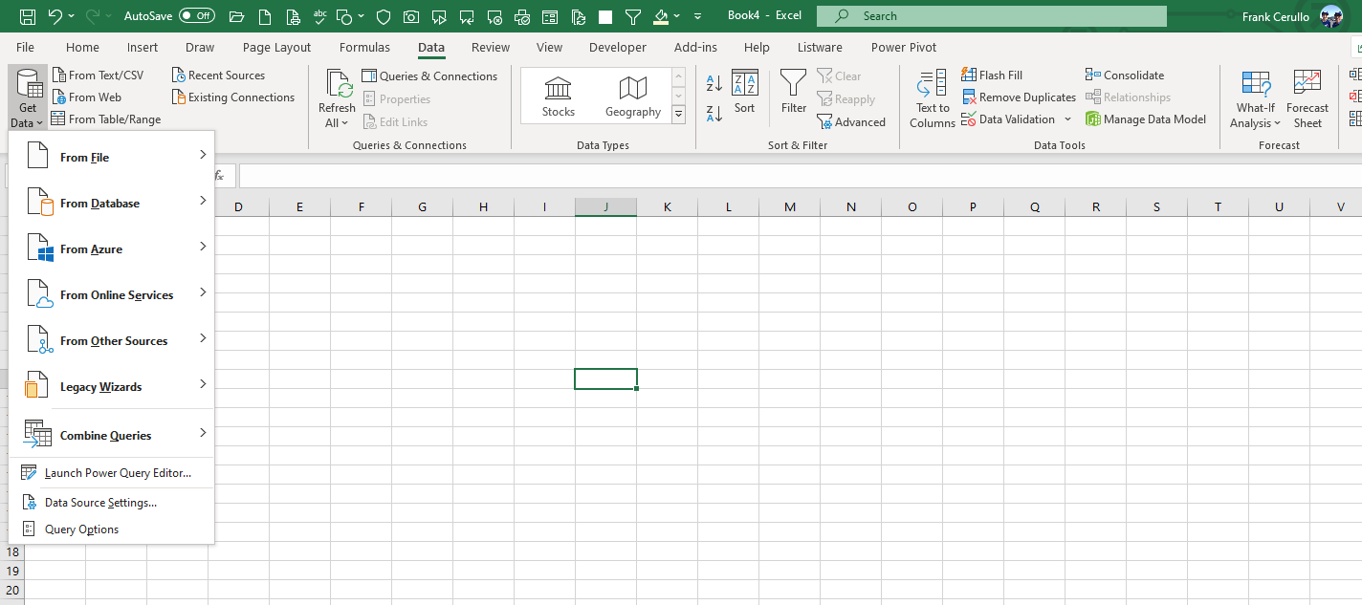
Entering data into ‘Cells’
On the ‘Data’ Tab
Get Data
Many others methods

Slide 22
Entering data: To create a new column
We want to add new Column(s) in between Column G Vendor Name and Column H Vendor Discount
Click Column G Header (on the letter itself) to highlight the entire Column G
Col G is now shaded

Slide 23
Entering data: To create a new column
Right Click
See the small Menu
Click “Insert”
A new column appears in Column G
It is empty and highlighted
The DATA in all Columns moves over one column to the right
What was in Column G now appears in Column H
What was in Column I now appears in Column J
You can now fill in whatever you want in Column G

Slide 24
Entering data: To create a new column
Add a title in Row 1 of the new column
By leaving it blank, we run the risk that Excel MAY treat the information to the left of the new column as separate from the information on the right

Slide 25
Quicker Data entry using Auto Fill
Type any month in any cell
Enter
Click on that same cell again
Grab the lower right corner of the cell
Drag down to Fill the cells below, or to the right
** Advanced Topic:
Excel comes standard with various versions of the months and days of the week, we can add Custom Lists, as well:
File => Advanced =>General=>Edit Custom Lists

Slide 26
Formatting

Slide 27
Agenda Excel Beginner
Formatting cells
“Others”
Number, including Serial Date concept
Other tricks

Slide 28
Formatting Cells includes 2 major sections: Number and Others
Others:
The way Excel LOOKS or SHOWS us information on screen or on paper
DOES NOT impact the calculations very much
Number
the way that we SEE information is not always the same as the way Excel USES that information
Currency, Serial Date, Text, etc..
In recent versions of Excel, you can now SORT by Color

Slide 29
Formatting: Other
Color:
Shading, or ‘coloring’ the cells background or Fill
Shading or ‘coloring’ the Font
Borders, Alignment, Font size, Bold etc.
Row height, Column Width; Hiding
Protection**
** Protection and security are Advanced topics

Slide 30
Formatting: Other Color
Simple method:
Select any Cell, Column, Row or range
Click the Home Tab
In the Font tab group, click the Paint can, or Font icon to change a color, or
In the Alignment tab group, select a different Alignment

Slide 31
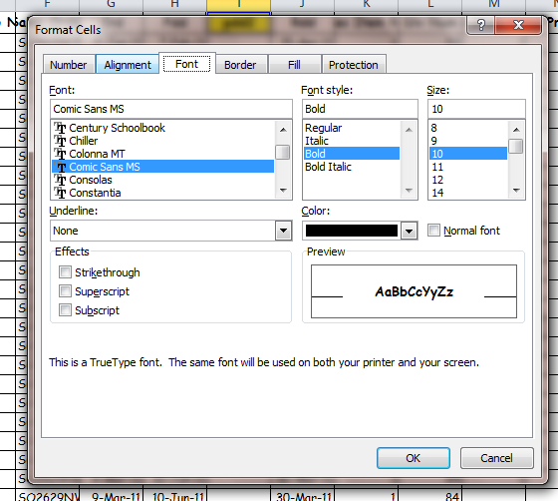
Formatting: Other, Color More control:
Click the Icon in the Font tab group to open the ‘Format Cells’ option box

Slide 32
Formatting: Other, Color More methods:
Use the Styles or Cells tab group

Slide 33
Formatting: Number
The way that we SEE information is not always the same as the way Excel USES that information
Several formats we can use, these are the ones that are most commonly used in business:
General
Number
Currency
Date

Slide 34
Formatting: Number General
Cells formatted as Number General, do not have any specific “look” or restrictions
Can be Alpha or Numeric
No decimals points
If the Column is not wide enough to display as written, it SHOWS as scientific notation
Suggested use: text fields, part numbers or other references ; where no calculations are needed

Slide 35
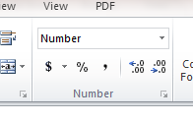
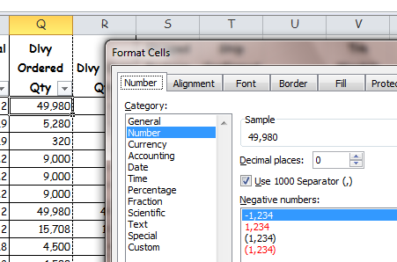
Formatting: Number Number
Can be alpha, but make sense when numeric only
Can show with or without the comma
Can show negatives with a dash, and/or in red, and/or in parentheses
Use the Number tab group or Format Cells option box to configure
Number tab group
Format Cells Option box

Slide 36
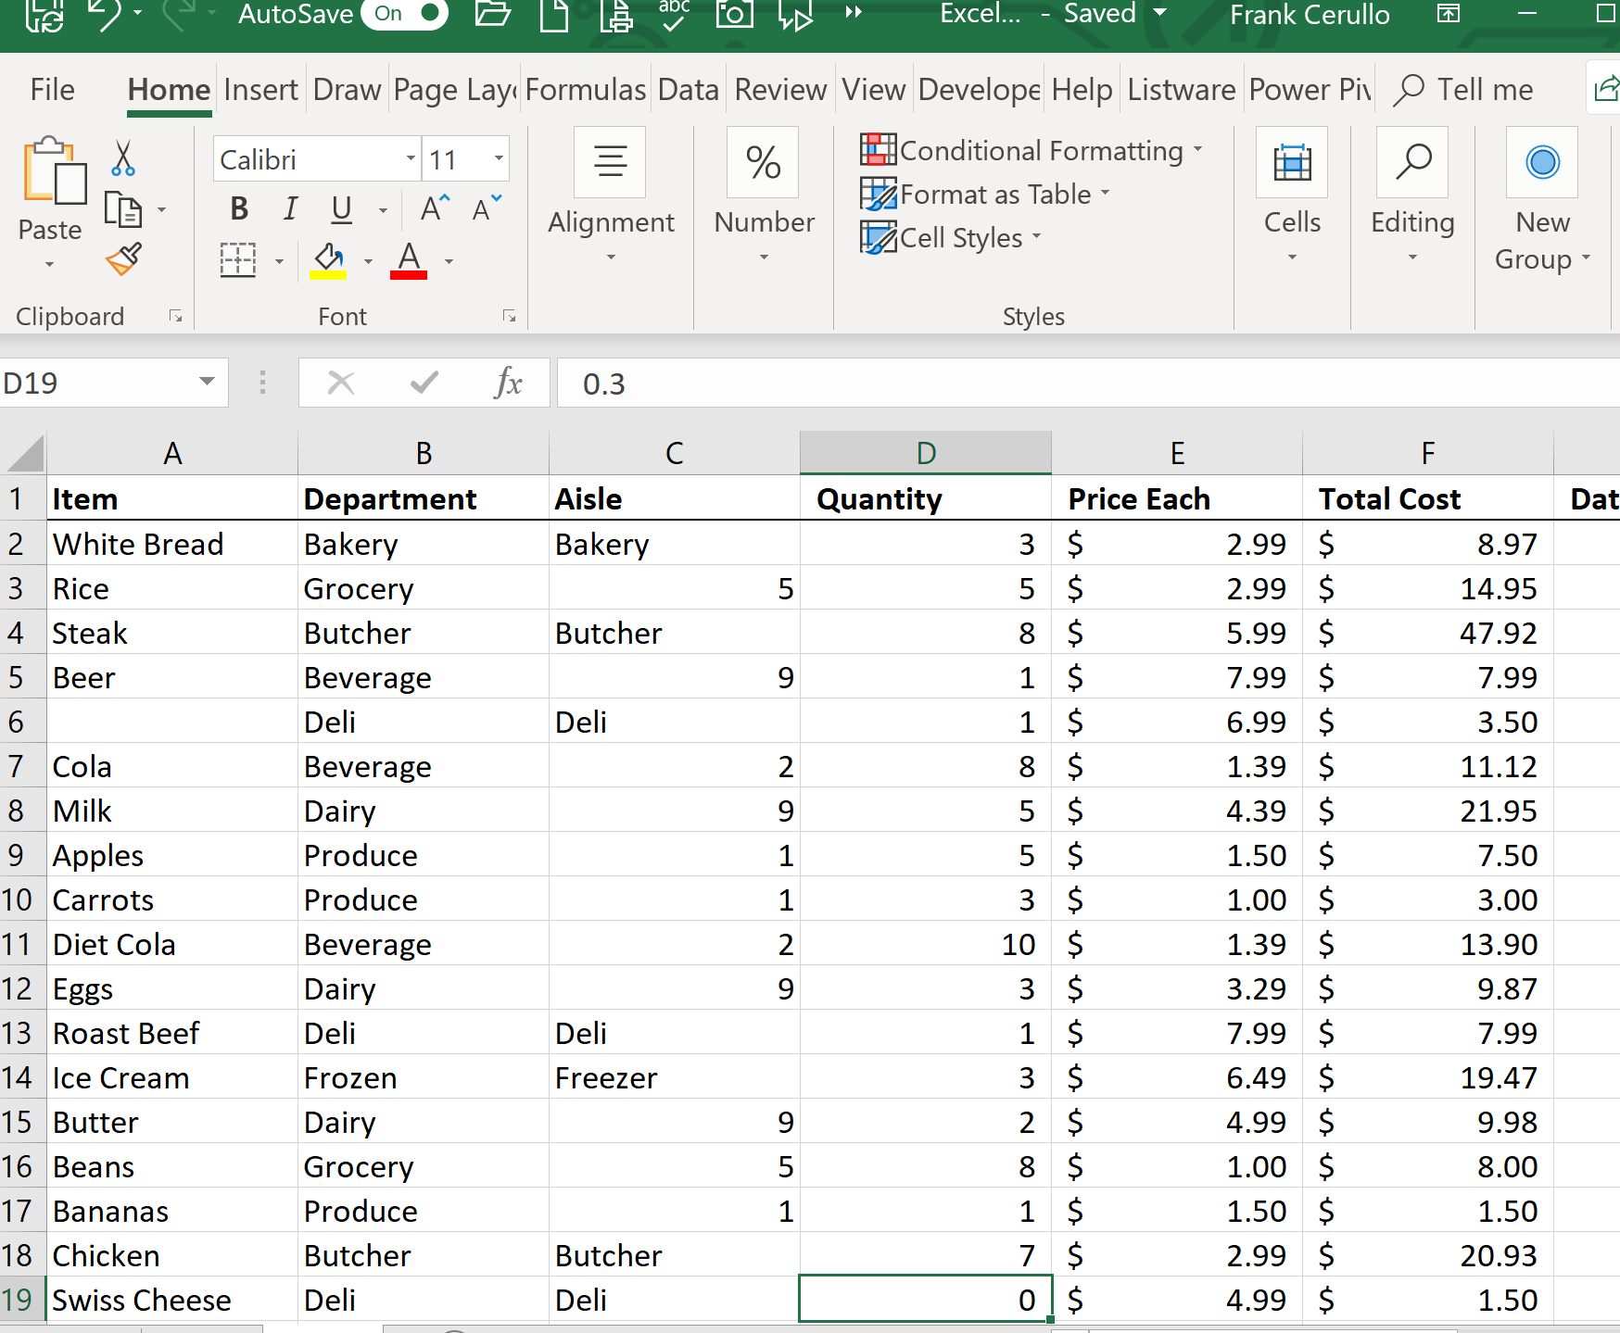
Formatting: Number Number
Can add a defined number of decimal points (or NO decimal points)
This does NOT round off the value, it just SHOWS it without the decimal
To check, click the cell, and look in the Formula Bar to confirm the full value is still in the spreadsheet
Suggested use: Numeric values, qty’s; counts; etc. where calculations are needed

Slide 37
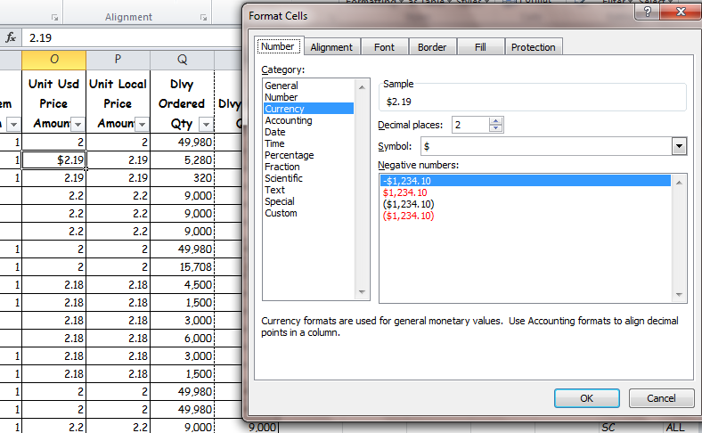
Formatting: Number Currency
Shows monetary values with an symbol ($ for US dollars; Y for Japanese Yen; etc..)
Does NOT calculate an exchange rate, it only displays the value with the symbol selected
Can add a defined number of decimal points (or NO decimal points)
This does NOT round off the value, it just SHOWS it without the decimal

Slide 38
Formatting: Number Date
Serial Date Concept: Every date from Jan 1st, 1900 thru Dec 31, 9999 has a serial number
Jan 1, 1900 = 1
Dec 31, 9999 = 2,958,465
There are nearly 3 Million days between those dates
It is a FORMATTING technique that shows a number in a format we can think about in terms of a date

Slide 39
Formatting: Number Date
There are 17 different option to display the date.
For Example: May 5th, 2018 = 43,225 can be shown as a date or a number as discussed above:
General: 43225
Number: 43225.00
Short date: 5/5/2018
Long Date: Saturday, May 05, 2018
Month-Year: M-18
others
Suggested use: Dates where calculations are needed

Slide 40
Formatting: Number Date
We can calculate on dates
From May 5th our example:
43225 +1 = 43226 is May 6th, 2018
Can use these in Functions and Formula
Will discuss further, below

Slide 41
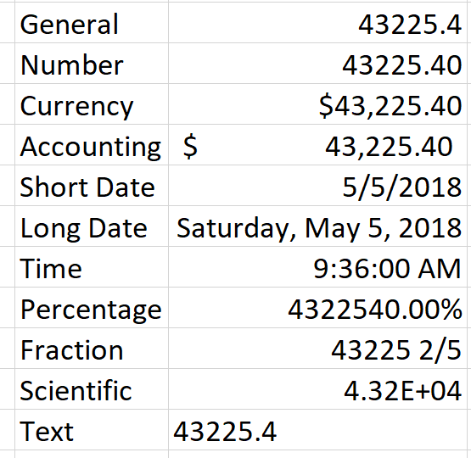
Sample of same “Value” shown in 10 different Formats

Slide 42
Other formatting tricks: Sheets can be re-named or re-colored
Rename it
Right click on the tab
Or click Tab Color…

Slide 43
Sheets can be re-named or re-colored
Select a Color

Slide 44
Sheets can be re-named or re-colored
Stay organized by having a different color for different categories, or different owners of information

